Slide 1
Dividends-a-Plenty: Unlock Value In These Turbulent Times
Presented by: The Dividend Kings

Slide 2
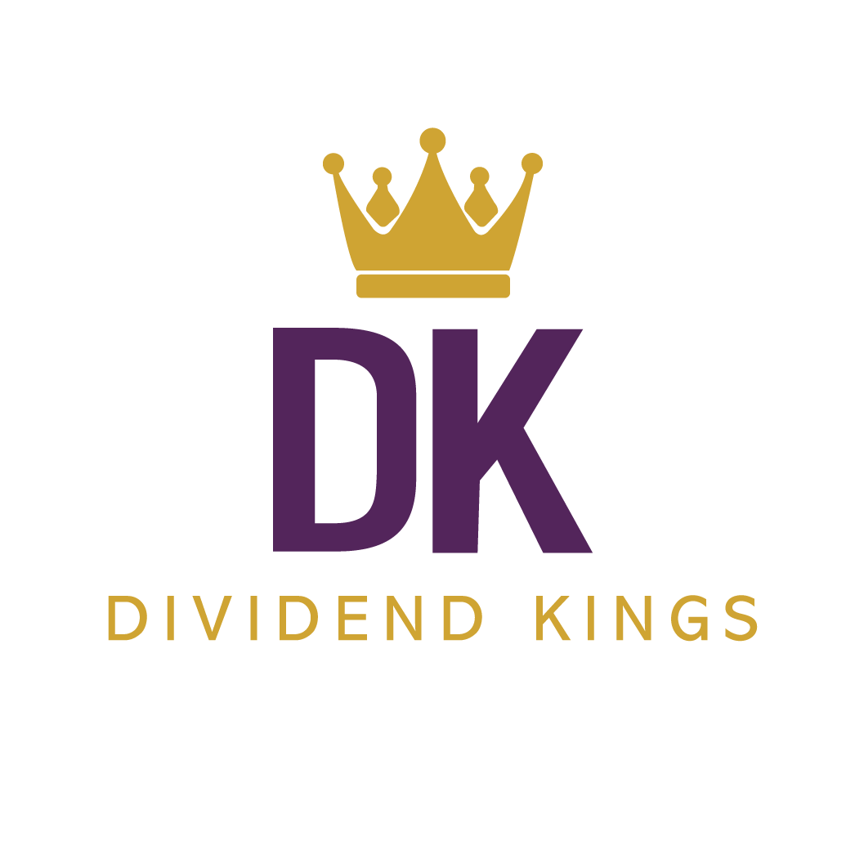
What Is The Dividend Kings
We're Value Investors
At The Dividend Kings, we pride ourselves on our ability to stay rational and use traditional value investing principles to identify attractive investment opportunities. And furthermore, with specific regard to the dividend growth space, this idea that stock selection and portfolio management should be business like is paramount to our success.

Slide 3
Our Team

Slide 4
Dividend Safety During This Recession
Quality & Safety
=
Safe Dividends Today and Exponentially
More Income Tomorrow

Slide 5
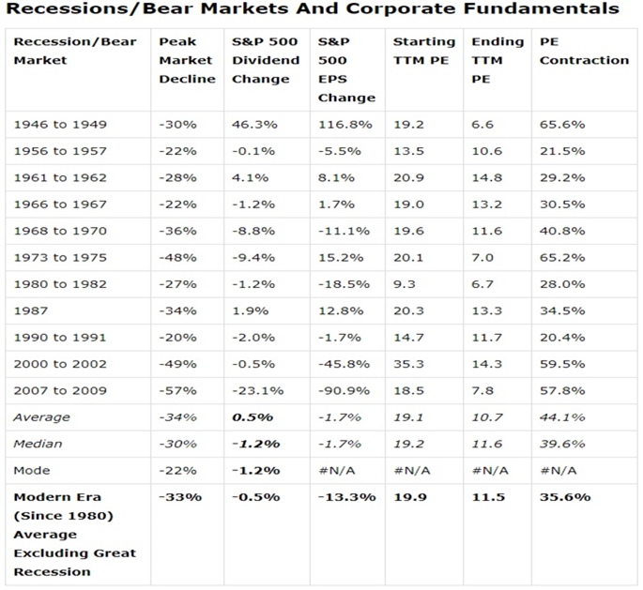
Dividend Cuts Are Relatively Rare in Normal Recessions

Slide 6
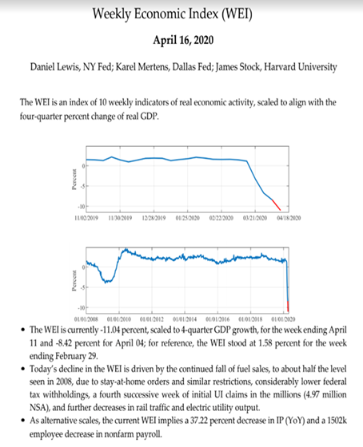
This Is NOT a Normal Recession

Slide 7
During Crisis Periods Dividend Cuts Are Far More Severe
Goldman Sachs estimates S&P 500 will cut its dividends about 25% during this recession.

Slide 8
Dividend Safety/Quality Are Priority #1 for Income Investors
Cash flow dividend sustainability
Strong balance sheets
Competent & trustworthy management
Good/excellent dividend growth records
Good solvency/low bankruptcy risk/low accounting fraud risk

Slide 9
Payout Ratio: Dividend Safety’s First Line of Defense
A safe payout ratio for oil & gas companies is 40%.
A safe payout ratio for retailers is 40%.
A safe payout ratio for banks is 50%.
A safe payout ratio for most corporations is 60%.
A safe payout ratio for consumer staples is 70%.
A safe payout ratio for utilities is 75%.
A safe payout ratio for midstreams is 83% (1.2 coverage ratio).
A safe payout ratio for low/medium-risk REITs (by industry) is 90%.
A safe payout ratio for healthcare REITs is 95%.
A safe payout ratio for certain higher-risk REIT industries is 70% for hotels, 75% for malls & industrials, and 80% for senior housing.
A safe payout ratio for YieldCos is 90%.

Slide 10
Balance Sheets: The Other Cornerstone of Dividend Safety
Debt/capital ratio
Credit rating
Debt/EBITDA
Interest coverage ratio
Advanced accounting metrics (Piotroski F-score, Altman Z-score, Beneish M-score)

Slide 11
Debt/Capital Safety Guidelines
Asset managers: 20% debt/capital is the safety guideline
Oil companies: 30%
Most corporations: 40%
Retailers and banks: 50% debt/capital
Higher-risk REITs: 50%
Utilities: 60%
Midstream: 60%
Most REITs: 60%
Tobacco companies: 60%
Consumer staples: 65%

Slide 12
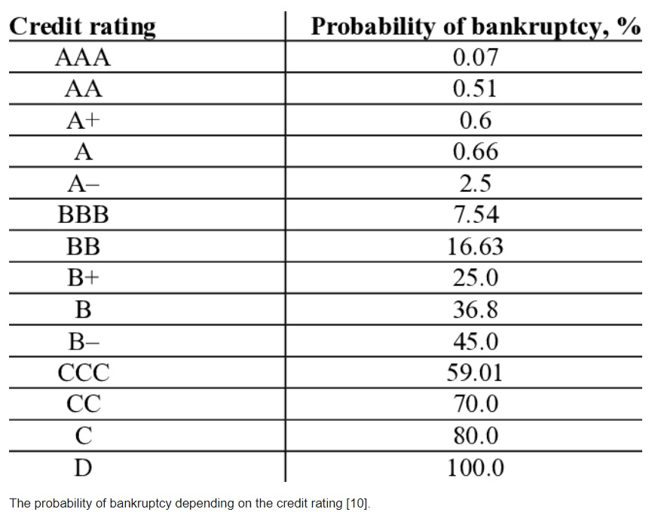
...AND Long-Term Bankruptcy Risk
Source: University of St. Petersburg

Slide 13
Debt/EBITDA: Safe Leverage = Safe Dividends
Oil companies: 1.5 debt/EBITDA or less
Semiconductor companies: 1.5 or less
Most corporations: 3.0 or less
Telecom: 3.5 or less
Consumer staples: 4.0 or less
Midstream MLPs/corporations: 5.0 or less
Utilities: 5.5 or less
Higher-risk REITs: 5.5 or less
Regular REITs: 6.0 or less
YieldCos (such as BEP, NEP, BIP): 6.0 or less

Slide 14
Interest Coverage: If Bond Investors Don’t Get Paid, Neither Do Dividend Investors
Oil companies: 10+
Retailers: 10+
Most corporations: 8+
Telecom: 4+
Utilities: 3+
Midstream MLPs/corporations: 2.5+
YieldCos (such as BEP, NEP, BIP): 2.5+
Higher-risk REITs: 2.5+
Regular REITs: 2+

Slide 15
Dividend Track Records: A Sign of Quality
“One of the most persuasive tests of high-quality is an uninterrupted record of dividend payments going back over many years. We think that a record of continuous dividend payments for the last 20 years or more is an important plus factor in the company’s quality rating.”
- Benjamin Graham, The Intelligent Investor

Slide 16
Advanced Accounting Metrics: The Relatively Easy Way to Spot Trouble Early
Piotroski F-score (immediate financial position): 0-3 unhealthy, 4-6 moderate healthy, 7-9 very healthy
Altman Z-score (short-term bankruptcy risk): 1.81 or less = distressed, 1.81-2.99 grey zone, 3+ = safe

Slide 17
Returns on Capital: Joel Greenblatt’s Favorite Quality Metric
“Businesses that earn a high return on capital are better than businesses that earn a low return on capital… Companies that achieve a high return on capital are likely to have a special advantage of some kind. That special advantage keeps competitors from destroying the ability to earn above-average profits.”
- Joel Greenblatt (40% CAGR total returns over 21 years at Gotham Capital)

Slide 18
Good Long-Term Investing: Easy to Do but Takes a Lifetime to Master

Slide 19
Great Athletes always go back to the fundamentals when their game goes off the rails.
Intelligent Dividend Investors should do the same.

Slide 20
Stock Investing is Always Risky
• The good news about investing in stocks is they are liquid.
• The bad news about investing in stocks is they are liquid.
• Volatility is not risk - Risk is how you react to volatility.

Slide 21
Market Timing is Impossible – Stock Prices are Unpredictable
Intelligent Dividend Investors Accept the Truth that Markets Misappraise Stocks

Slide 22
When Investing in Stocks - Only Dividends are Predicable and Consistent
Dividends are Paid on the Number of Shares You Own – Not the Current Price

Slide 23
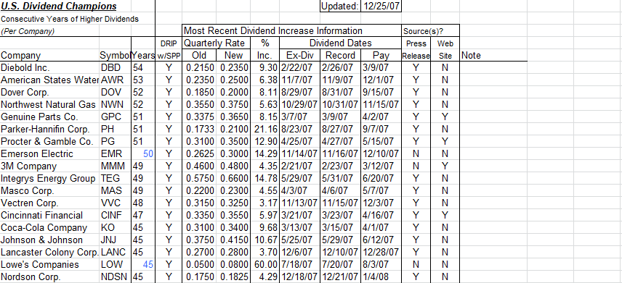
Dividend Champions: History
Dividend Aristocrats – S&P 500 companies which have increased dividends 25 or more consecutive years
Dividend Champions – all companies with 5 or more years of dividend growth
Created by David Fish in 2008
Expanded to include more companies and more data
Currently maintained by Justin Law

Slide 24
Dividend Champions: Methodology
Dividend growth streaks calculated by calendar year and payout date
Split adjusted
Excludes special dividends
Exceptions made for special circumstances

Slide 25
Why are dividend growth streaks important?
Companies with longer dividend growth streaks are less likely to cut or freeze dividends
Since February, 82% of dividend cuts or suspensions have been from companies with dividend growth streaks of less than 12 years.

Slide 26
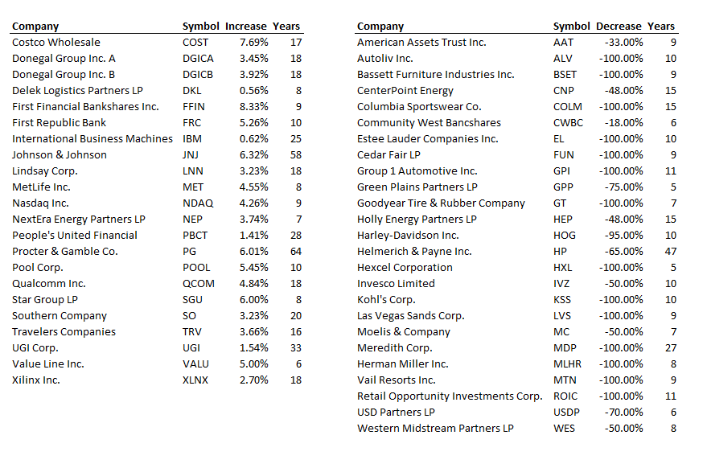
April 2020 Dividend Champions Hall of Fame / Hall of Shame
Fame
Shame

Slide 27
Data Analysis

Slide 28
Data Analysis

Slide 29
Data Analysis

Slide 30
Data Analysis

Slide 31
Data Analysis

Slide 32
Data Analysis

Slide 33
Data Analysis

